Slide 1
Sample of Nike shoe

Slide 2
Printing Data
Weight: 5kg
Size: X*97 Y*39 Z*40
Printing time:
For maximum efficiency the shoe was printed in 2 parts:
Part 1 (front): estimated time: 5 hours
Part 2 (back): estimated time: 9 hours
Print mode: Quality, Double wall

Slide 3
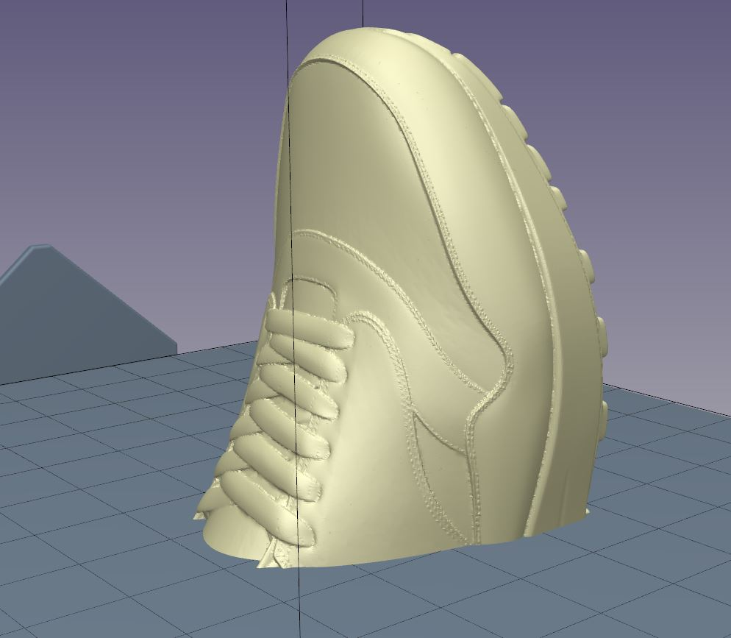
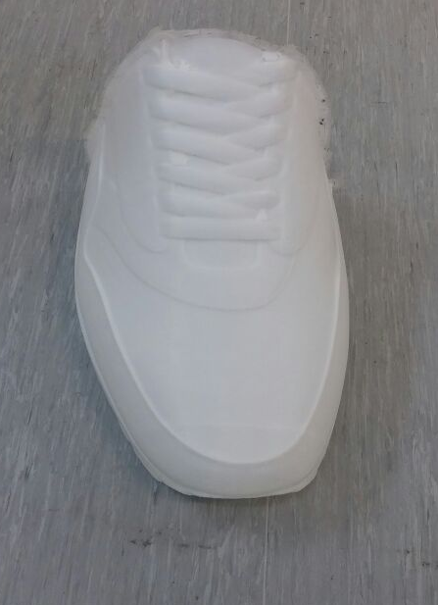
Part 1

Slide 4
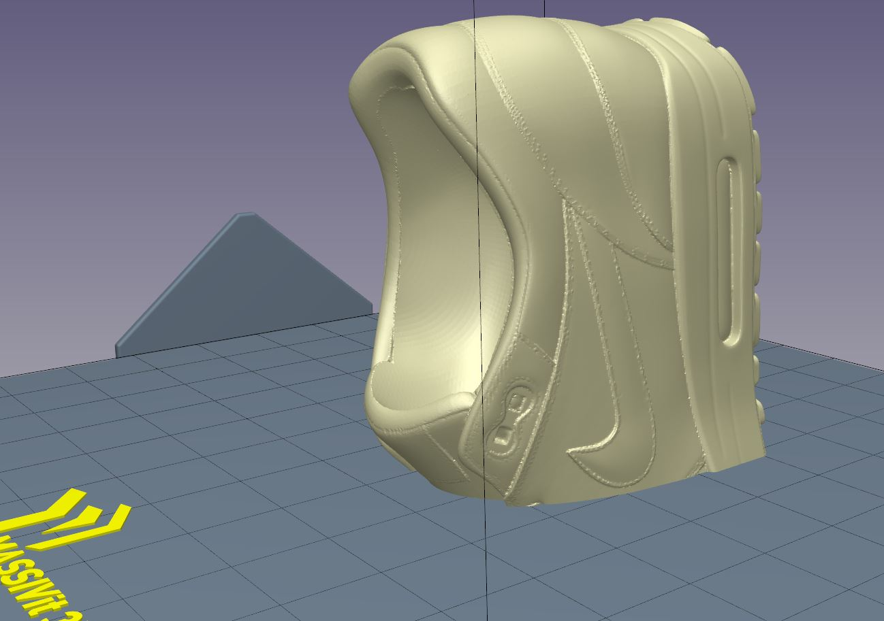
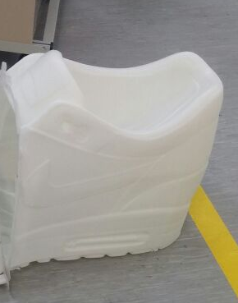
Part 2

Slide 5
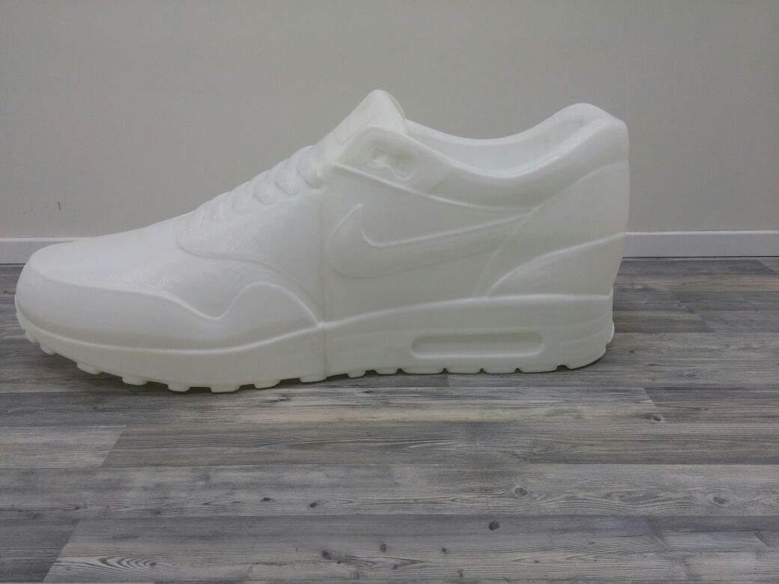
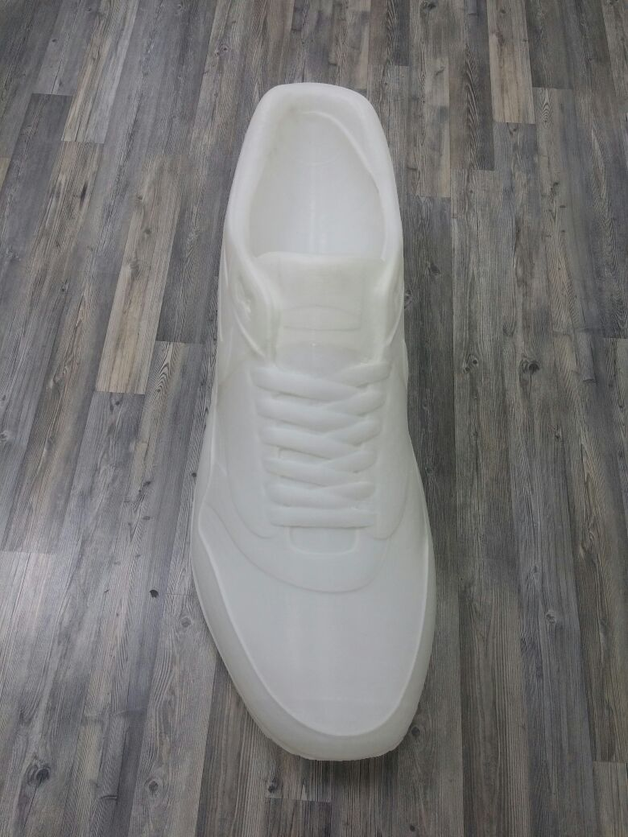
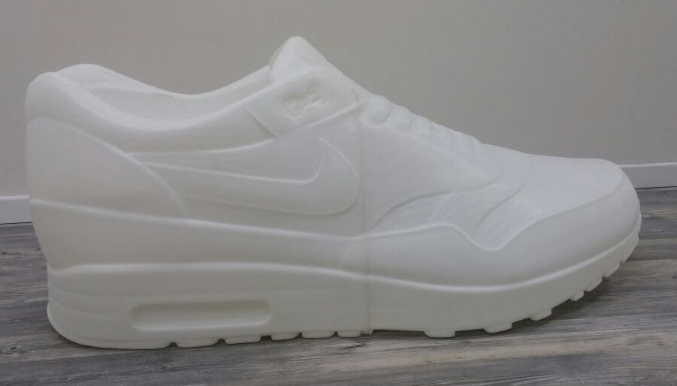
Final Model

